Slide 1
Student Exchange Program
November 2019

Slide 2
General Information
The Coller School of Management
has exchange agreements with more than 90 leading Business Schools around the globe

Slide 3
Partner Schools
WITS, South Africa
Kellogg, USA
McGill, Canada
ESADE, Spain
Solvay, Belgium
Warwick, UK
Copenhagen School, Denmark
Melbourne School, Australia
ITAM, Mexico
Cornell, USA
Torcuato Di Tella, Argentina
Catolica Lisbon, Portugal
Keio, Japan
Cologne, Germany
Bocconi, Italy
HEC, France
Tsinghua , China
ISB, India
FGV, Brazil
Duke, USA
Turku, Finland
Humboldt, Germany
Yonsei, South Korea
ESAN, Peru
Rotterdam School, Netherlands
NUS, Singapore

Slide 4
About the Program
It’s a unique experience…
What’s unique about it?
Exposure to the local business ecosystem;
Building an international network;
A wide variety of courses;
Diversity of people and backgrounds;
Many extra-curricular activities;
Gaining language skills.

Slide 5
About the Program
It’s a unique experience, but it comes with a price!
Why?
Application process, Visas, Accommodation, Insurance, Choosing courses, etc.
Effects your everyday life (work, internships, family, partners, friends)
Unknown environment
Cultural differences
Not cheap

Slide 6
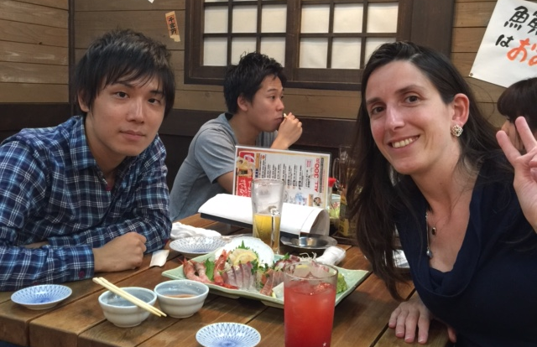
but it’s worth it…

Slide 7
When can I study abroad?
Summer term which usually begins in May, June or July and is usually shorter in duration;
Fall Semester which usually begins in August or September.
Which courses can I take while on exchange?
Elective courses on a wide variety of topics;
Language courses will not be recognized as part of your degree in terms of credits;
Courses that are equivalent to those you have already taken at Coller will not be approved!

Slide 8
Eligibility
A successful applicant:
Completed 8 semester units of core courses;
Have a GPA of at least 80;
Have at least 2 academic units to complete at the host
university (and not more than 6 credits);
2-3 years of work experience (preferably in managerial
positions).
Please note that most schools do not accept applicants who have previously lived/studied in the country in which they are located. Nor do they accept applicants who are citizens of their country.

Slide 9
Application Process
Fill in the application form;
Rank 8 overseas destinations in your order of preference;
Some of you will be invited for a personal interview;
Since the number of places is limited, the selection will be based on the above criteria, bearing in mind your individual preferences.
Registration will open around the end of December.
Candidates are notified regarding their placements by the beginning of April.

Slide 10
How to choose a school?
Think about your future goals;
Read exchange summaries online;
Talk to people who have been there (even with your professors);
Check how many spots are available for Coller students at the host school?
Check where is the host school located?
Check your budget;
Be realistic and strategic about your choices (and consider emerging markets);

Slide 11
Think about Asia…
INDIA, CHINA, JAPAN, TAIWAN, SINGAPORE, SOUTH KOREA
Business opportunities:
According to a report by PWC (02/2017), China will be the most powerful economy by 2030.
With so many companies setting up branches in Asia, there’s plenty of opportunities to gain industry experience.

Slide 12
Think about Asia…

Slide 13
Think about Asia…
Language:
1.4 billion native speakers make Mandarin Chinese the most spoken language in the world. And it’s useful outside of China as well (for example in Taiwan and Singapore).
Affordability:
The living costs in Asia are generally considerably lower than in Europe or the US.
Ranking:
Asian students and schools receive continuously top marks in international rankings.

Slide 14
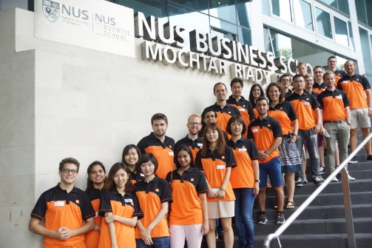
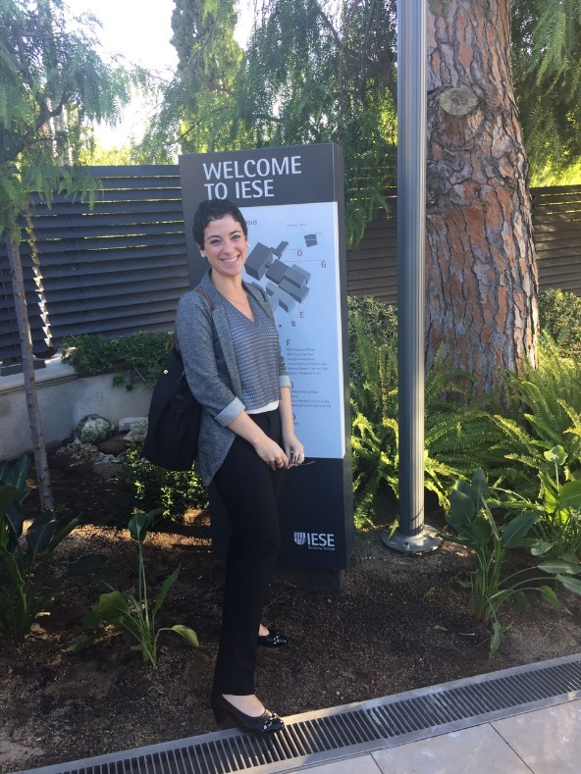
To sum it up
It is a great opportunity and an amazing experience;
But it comes with a price!
Talk to people who have been there;
Keep an open mind.

Slide 15
Contact Info
You are most welcome to contact me:
Email: hilara@tauex.tau.ac.il
Phone: 03-6048069
Mail: Box Number 451 (second floor)
Directly: Room 211 (next to Inbal’s office)
Website: https://en-coller.tau.ac.il/imba/learning-journey/semester-abroad/admission/?tab=5

